Slide 1
Attention, in parallel
Multi-Head Attention
How h attention heads run in parallel and recombine — building on the single-head walkthrough.
n = 3 tokens d_model = 512 num_heads = 8 d_k = 64
Recap of one head: X (3,512) → project to Q, K, V (3,64) → scores (3,3) → softmax → output (3,64). Multi-head runs eight of these side by side.

Slide 2
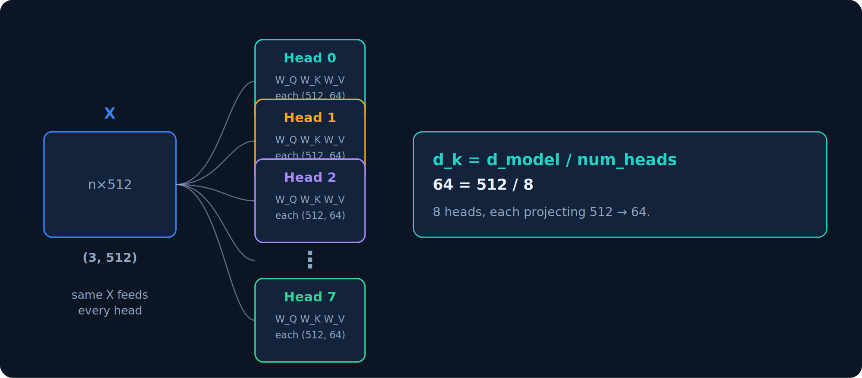
Setup
Setup — split d_model across heads
Instead of one wide attention, use 8 heads — each with its own smaller slice of the representation.
Same X (3,512) feeds every head; only the weights differ. d_k = d_model / num_heads = 512 / 8 = 64 — the split is what lets heads concatenate back to 512 later.

Slide 3
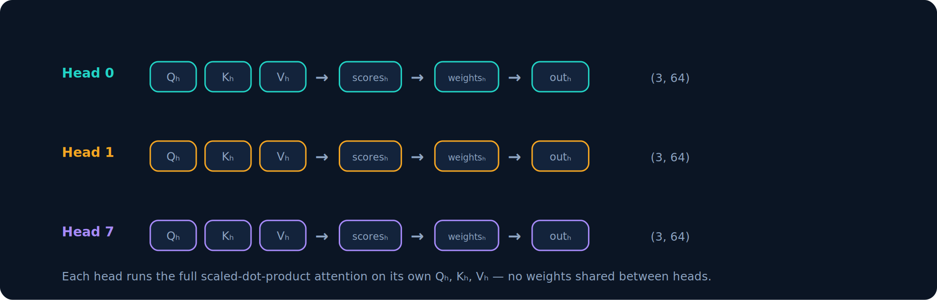
Step 1
Step 1 — each head attends independently
Every head runs the same scaled-dot-product attention from the single-head deck — on its own Q, K, V.
Qₕ = X·W_Qₕ, Kₕ, Vₕ all (3,64); scoresₕ (3,3); weightsₕ = softmax(scoresₕ/√d_k); outₕ = weightsₕ·Vₕ (3,64). No weights shared between heads — that is what enables specialization.

Slide 4
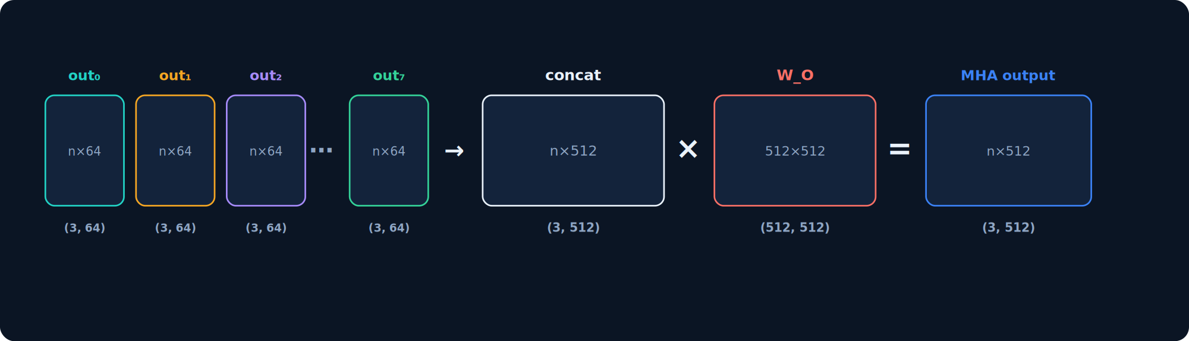
Step 2
Step 2 — concatenate and project
Stick all 8 head outputs back together to width 512, then mix them with one more learned matrix.
concat = [out₀ | out₁ | … | out₇] # 8 × (3,64) -> (3,512) MHA = concat @ W_O # (3,512)@(512,512) -> (3,512)
Output (3,512) matches the input X — so multi-head attention slots cleanly into the residual stream and layers can stack.

Slide 5
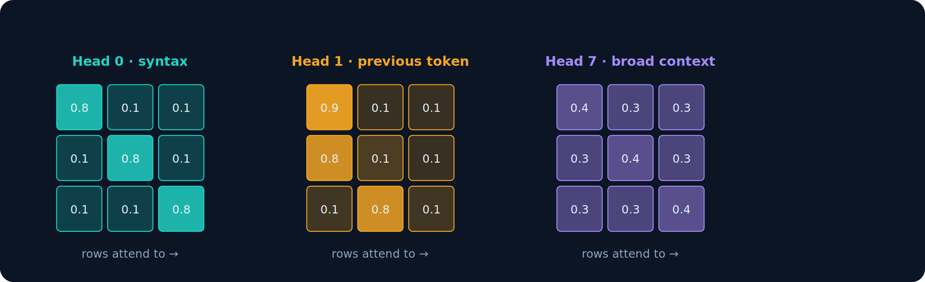
Insight
Why multiple heads — specialization
Because each head has its own weights, each learns a different attention pattern.
Each grid is a head's weights (3,3); darker = stronger attention. Trained heads specialize (previous-token, syntax, broad context). Labels are illustrative — roles emerge from training, they are not assigned.

Slide 6
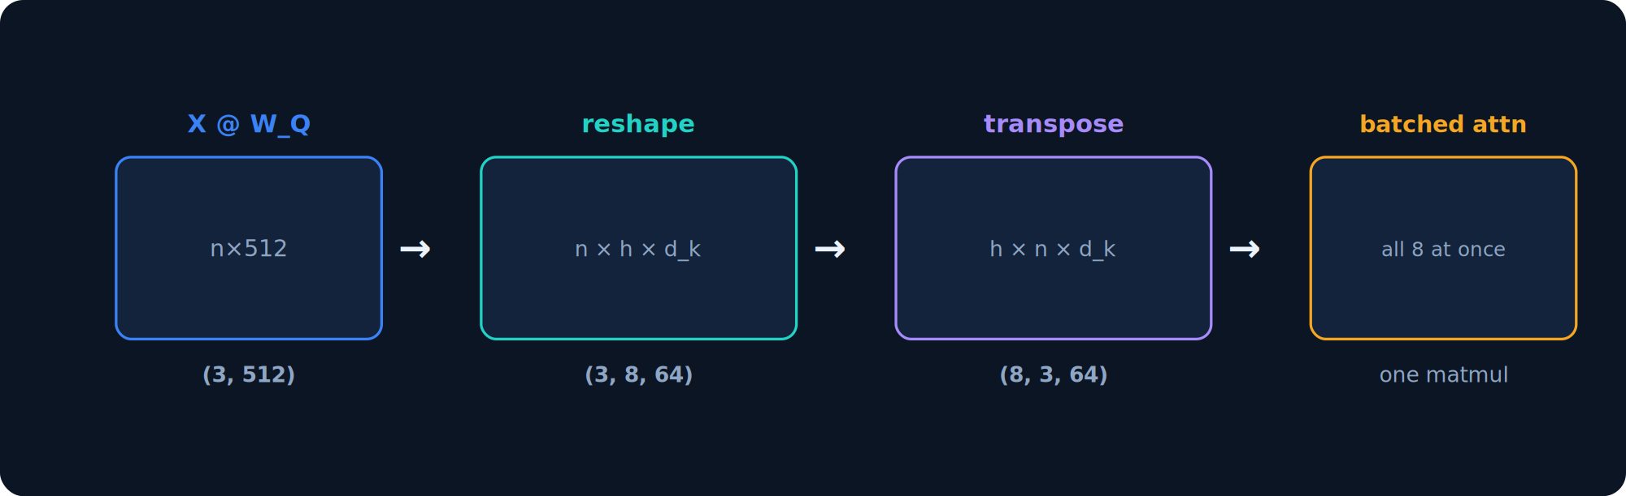
Practice
In practice — one batched tensor, not a loop
Real implementations reshape and run all heads as a single batched matmul.
Q = (X @ W_Q).view(n, num_heads, d_k).transpose(0, 1) # (8, 3, 64)
W_Q, W_K, W_V are single (512,512) matrices; the 512 is reshaped into 8×64 and heads become a batch dimension. Same math as slide 3, far faster on a GPU.

Slide 7
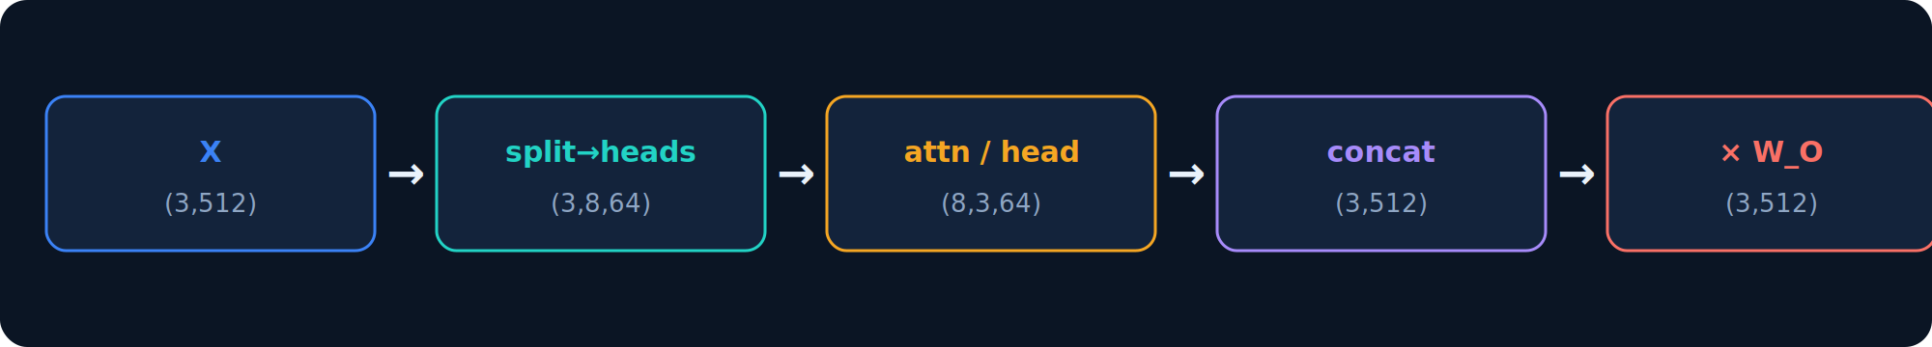
Recap
Recap — the whole layer, end to end
512 in → split into 8×64 → attend per head → concat back to 512 → mix with W_O → 512 out.
import math, torch import torch.nn.functional as F
d_model, num_heads =
512, 8 d_k = d_model // num_heads # 64
def
multi_head_attention(X, W_Q, W_K, W_V, W_O): n = X.shape[0] def split(M): return M.view(n, num_heads, d_k).transpose(0, 1) Q, K, V = split(X @ W_Q), split(X @ W_K), split(X @ W_V) # (8,3,64) scores = Q @ K.transpose(-2, -1) / math.sqrt(d_k) # (8,3,3) weights = F.softmax(scores, dim=-1) heads = weights @ V # (8,3,64) concat = heads.transpose(0, 1).reshape(n, d_model) # (3,512) return concat @ W_O # (3,512)

